Slide 1
Venture Capital
Target Audience
The sales strategy is primarily targeted at international B2B customers, specifically the procurement

Slide 2
Sales Strategy
COMMUNI
CONTENTS
01. Strategy Overview
03. Problem Identification
02. Solution Presentation
04. Implementation Plan

Slide 3
Sales Strategy
COMMUNI
PART ONE
Strategy Overview
The sales strategy is primarily targeted at international B2B customers, specifically the procurement
Sales Strategy

Slide 4
Sales Strategy
COMMUNI
International
Customer Pain Points
The sales strategy is primarily targeted at international B2B customers, specifically the procurement
Customers face issues like high cross - regional order fulfillment costs (more than 8% of revenue compared to the industry best of ≤4%)
Market Scope
Target Audience
These customers are crucial for achieving the goal of locking in POC or annual prepaid contracts worth at least $1.2M ARR.
and ESG audit non - compliance with potential EU EPR fines of €35k/year.

Slide 5
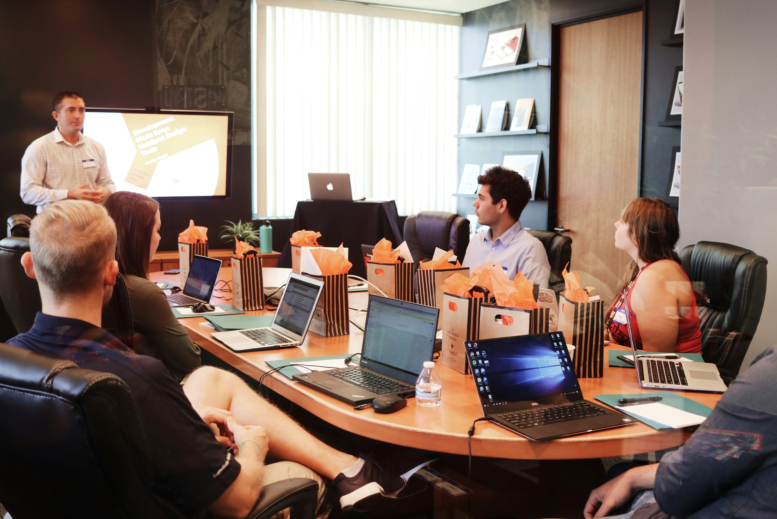
Sales Strategy
COMMUNI
Core Objectives
The main objective is to secure POC or annual prepaid contracts with a total value of at least $1.2M ARR during the 30 - minute English roadshow for international B2B customers.
Clearly demonstrate the return on investment (ROI) to customers within 30 minutes, along with a path to ESG compliance, to convince them of the value of the solution.
256K

Slide 6
Sales Strategy
COMMUNI
Market Analysis
Market Trends
Convince customers of the effectiveness and suitability of the proposed solution by addressing their pain points and showing how it can improve their business operations and financial performance.
Each module in the presentation has a specific time allocation, for example, the Hook module takes 2 minutes, and the Situation module takes 3 minutes, ensuring a well - paced and comprehensive presentation.
Market Challenges
The presentation is structured based on the SPIN (Situation, Problem, Implication, Need - payoff) model combined with the value三段论 and the institutional distance framework. This helps in systematically addressing customer needs

Slide 7
Sales Strategy
COMMUNI
PART TWO
Problem Identification
The sales strategy is primarily targeted at international B2B customers, specifically the procurement
Sales Strategy

Slide 8

Sales Strategy
COMMUNI
Presentation Structure
Key Outputs
Content Conciseness
Manual processes lead to various costs, including inventory fines, expedited shipping fees, and opportunity costs, amounting to €1.2M per year according to customer interviews and McKinsey data.
Each slide contains no more than 45 words and one key point per image
Storytelling
Manual Processes
Each slide contains no more than 45 words and one key point per image
Data sources are clearly marked at the bottom - left corner of the slide

Slide 9
Sales Strategy
COMMUNI
Regulatory and Compliance Problems
ESG Audit Non - compliance
Customers face ESG audit non - compliance issues, which may lead to EU EPR fines of €35k per year. This non - compliance also affects the company's reputation and future business opportunities.
$186K
%52.08+
%48.02-
$257K

Slide 10

Sales Strategy
COMMUNI
Changing Regulations
Automated Screen Recording
There are upcoming regulatory changes, such as the 2025 EU Packaging Law, which will increase the EPR fees for disposable cardboard by 35%. This requires companies to adapt quickly to avoid additional costs.
Highlight
simply demy
Ipsum
This allows the audience to quickly
This allows the audience to quickly
This allows the audience to quickly

Slide 11
Sales Strategy
COMMUNI
PART THREE
Solution Presentation
The sales strategy is primarily targeted at international B2B customers, specifically the procurement
Sales Strategy

Slide 12
Sales Strategy
COMMUNI
Value Demonstration
The current order cycle is long, and the goal is to reduce it by 35%. A long order cycle affects inventory management and customer satisfaction.
Real - time ROI Calculator
Case Studies
Scenario Demo
A real - time ROI calculator is provided, which allows customers to input parameters such as annual
see the potential savings in euros and carbon emissions reduction (e.g., 420kg of carbon reduction per 1k orders).
Third - party audited case studies, like the German home appliance customer who saved €2.1M in 12 months with an ROI of 318%

Slide 13
Sales Strategy
COMMUNI
Three - Act Structure
Solution Architecture
The solution has a three - act architecture consisting of the process layer, data layer, and experience layer
This structure provides a comprehensive and integrated approach to solving customer problems.
The process - layer solution includes features like drag - and - drop quoting, automatic BOM generation

Slide 14
Sales Strategy
COMMUNI
2×2 Matrix Analysis
Industry Exhibitions
A 2×2 matrix comparing price, recyclability, and carbon intensity is used to show the product's position
The solution differentiates itself from competitors by offering features like fast integration with major systems, real - time inventory verification, and significant carbon emissions reduction, which address customer pain points more effectively.

Slide 15
Sales Strategy
COMMUNI
PART FOUR
Implementation Plan
The sales strategy is primarily targeted at international B2B customers, specifically the procurement
Sales Strategy

Slide 16

Sales Strategy
COMMUNI
Service and SLA
The company provides 7×24 multi - language service with a mean time to repair (MTTR) of less than 4h and a high quota completion rate (90%+) through weekly CSM meetings, which is a competitive advantage in the market.
VR and AR Applications
In the future, smart building technology will be a key area of innovation in the real estate industry

Slide 17


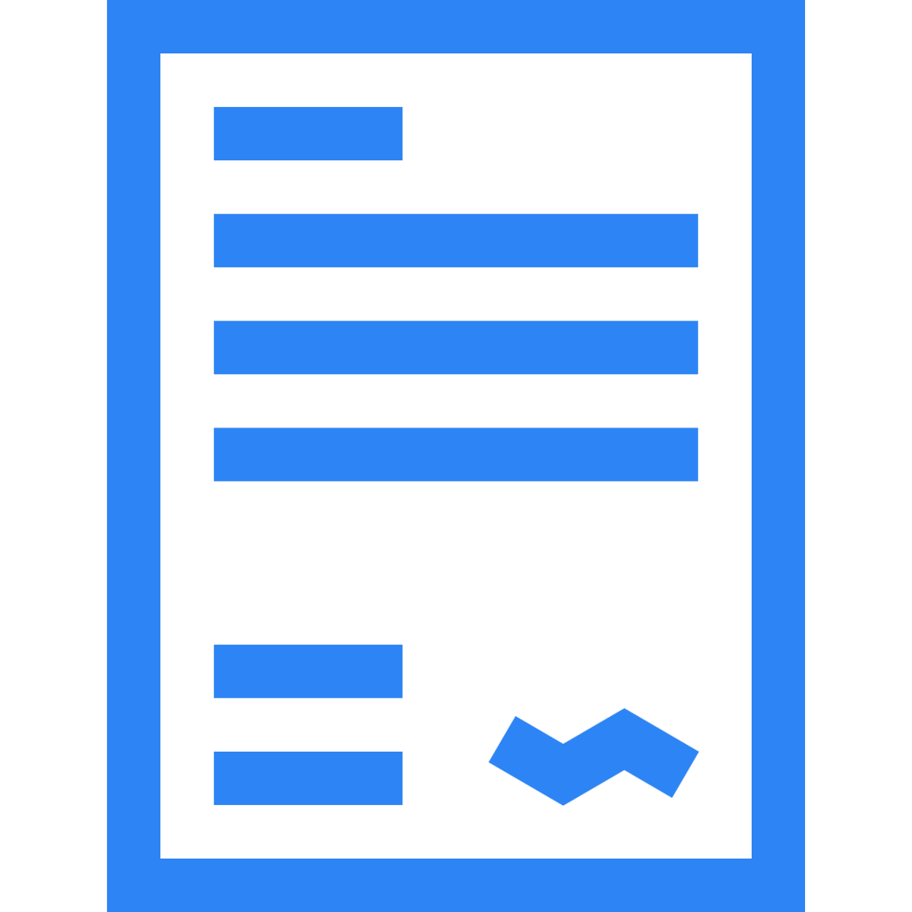



Sales Strategy
COMMUNI
Multi - language Service
MTTR and CSM Meetings
Promoting green building standards
Using renewable energy sources in real
Through marketing activities
With a mean time to repair (MTTR) of less than 4h and regular CSM (Customer Success Manager) meetings, the company can quickly address customer issues and ensure high customer satisfaction.

Slide 18
Sales Strategy
COMMUNI
90 - Day Roadmap
Full - scale Promotion
API Docking
In the first phase of the 90 - day roadmap, API docking with relevant systems like SAP/Oracle will be carried out
Pilot Project
A pilot project with 500 boxes will be launched to test the solution in a real - world environment

Slide 19

Sales Strategy
COMMUNI
THANK YOU
Target Audience
Our company focuses on AI - Driven Micro - Fulfillment for Fresh Groceries

